Slide 1
BML. 3. Intro to MCMC From Gibbs to Hamilton
DataLab CSIC

Slide 2
Brief description
1. presented key methods in Bayesian inference and basic models and faced ‘severe’ computational problems quite rapidly (beta-binomial, logistic regression)
2. overviewed Bayesian computational strategies
3. Will focus on MCMC (Markov chain Monte Carlo): Gibbs, Metropolis, Hybrid, Hamiltonian.
Other stuff, including SG-MCMC later on

Slide 3
Computational problems in Bayesian analysis
Computing the posterior
Computing posterior expectations

Slide 4
General idea MCMC
Markov chain Xn with same state space as target and convergent to target distribution g
Strategy

Slide 5
a. Gibbs sampling

Slide 6
Sources
French and DRI (2000) Ch 7
DRI et al (2010) Ch4
BDA3 (2015) Ch11, 12
Hoff (2009) Ch 6,7

Slide 7
Labs
3.1 Gibbs
Basic, Re-usable,Paralel chains
Multivariate normal
Normal-gamma inverse

Slide 8
Generic Gibbs sampler

Slide 9
Important Gibbs sampling examples

Slide 10
Purpose
Through several important examples reinforce Gibb sampling concept
Motivation
Model and prior
Posterior conditionals
Gibbs sampler
Use
(Many implemented in labs)

Slide 11
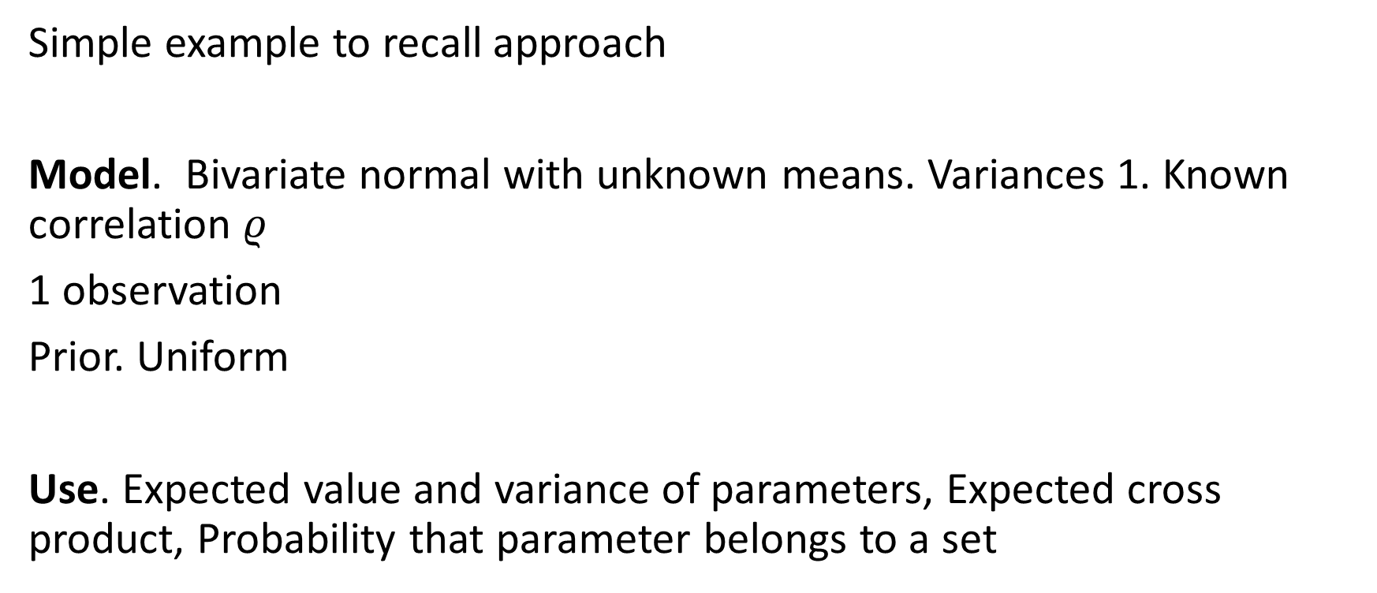
Sampling the bi-variate normal
Simple example to recall approach
Model. Bivariate normal with unknown means. Variances 1. Known correlation $ρ$
1 observation
Prior. Uniform
Use. Expected value and variance of parameters, Expected cross product, Probability that parameter belongs to a set

Slide 12
Auxiliary result (eg Handbook of the Normal Distribution)

Slide 13
Sampling the bi-variate normal. Model and posterior

Slide 14
Sampling the bi-variate normal. Gibbs sampler

Slide 15
Sampling the bi-variate normal. Answers

Slide 16
Inference for normal-gamma
A very important example. Analytic solution available. Serves as benchmark
Model. Normal with unknown mean and variance. Prior normal-gamma.
Use. Quartiles of mean, Interval of probability 0.7, Test null that mean is bigger than 0
https://en.wikipedia.org/wiki/Inverse-gamma_distribution
https://en.wikipedia.org/wiki/Normal-inverse-gamma_distribution

Slide 17
Inference for normal-gamma. Model

Slide 18
Inference for normal-gamma. Conditional

Slide 19
Inference for normal-gamma. Sampler

Slide 20
Inference for normal-gamma. Answers

Slide 21
Inference for a mixture of exponentials
An example with mixtures. Very important in modern statistics and machine learning, e.g. Latent Dirichlet allocation. Used in clustering, density estimation,… Also introduces latent variables.
Model. Mixture of k exponentials, gamma priors. Dirichlet-multinomial on labels.
Use. Predictive distribution, group for first observation
https://en.wikipedia.org/wiki/Multinomial_distribution
https://en.wikipedia.org/wiki/Dirichlet_distribution
https://en.wikipedia.org/wiki/Latent_Dirichlet_allocation

Slide 22
Inference for a mixture of exponentials
Model

Slide 23
Inference for a mixture of exponentials
Latent variables

Slide 24
Inference for a mixture of exponentials
Posterior conditionals

Slide 25
Inference for a mixture of exponentials
Gibbs sampler

Slide 26
Inference for a mixture of exponentials
Answers

Slide 27
Inference for normal multivariate
Again ultra-important. Bread and butter of multivariate analysis
Model. Multivariate normal (means and covariance matrix). Normal-Wishart prior
Use. Expected value of maximum, Probability that product of means is bigger than 4
https://en.wikipedia.org/wiki/Wishart_distribution

Slide 28
Inference for normal multivariate
Model

Slide 29
Inference for normal multivariate
Posterior conditionals

Slide 30
Inference for normal multivariate
Gibbs sampler

Slide 31
Inference for normal multivariate
Answers

Slide 32
Gibbs sampling theory

Slide 33
Recall

Slide 34
Convergence
Kernel

Slide 35
b. Metropolis Hastings algos

Slide 36
Brief description
The intro presented key methods in Bayesian inference and basic models and faced ‘severe’ computational problems quite rapidly (beta-binomial, logistic regression)
We have introduced MCMC and Gibbs sampling
We focus here on Metropolis-Hastings and hybrid samplers
More to be followed

Slide 37
Sources
French and DRI (2000) Ch 7
DRI et al (2010) Ch4
BDA3 (2015) Ch11, 12
Hoff (2009) Ch 6,7

Slide 38
Labs
3.2 Metropolis
Basic, Standard, MH
Multivariate normal
Linear regression (ecology)
Poisson regression (ecology)

Slide 39
Understanding the Metropolis-Hastings algorithm

Slide 40
Recall: Acceptance-rejection sampling

Slide 41
Metropolis-Hastings rationale I
Transition kernel of Markov chain
Invariant distribution
n-th iterate

Slide 42
Metropolis-Hastings rationale II
Invariant distribution and reversibility. Suppose that for p kernel (x,y)

Slide 43
Metropolis-Hastings rationale III
Adjusting a candidate generating distribution

Slide 44
Metropolis-Hastings rationale IV
Balance condition
Observations
Normalising constant not required
If q symmetric, Metropolis

Slide 45
Metropolis-Hastings algo

Slide 46
Metropolis-Hastings variants I
Random walk chain
Metropolis algorithm
Independence chain

Slide 47
Metropolis-Hastings variants II
Exploiting form of target
Acceptance rate not too high, not too low (23%). Tuning parameters

Slide 48
Examples

Slide 49
Sampling the bi-variate normal
Simple example to recall approach
Model. Bivariate normal with unknown means. Variances 1. Known correlation $ρ$
1 observation
Prior. Uniform
Use. Expected value and variance of parameters, Expected cross product, Probability that parameter belongs to a set

Slide 50
Sampling the bi-variate normal. Model and posterior

Slide 51
Sampling the bi-variate normal. Gibbs sampler

Slide 52
Sampling the bi-variate normal. Metropolis Hastings

Slide 53
Sampling the bi-variate normal. Metropolis Hastings

Slide 54
Sampling the bi-variate normal. Answers….

Slide 55
Bayesian Probit Regression

Slide 56
Bayesian Probit Regression MH

Slide 57
Bayesian Poisson Regression. Offspring of birds given age

Slide 58
Bayesian Poisson Regression
Offspring Y given age?? Per age?? Linear??

Slide 59
Bayesian Poisson Regression
Prior and posterior
Acceptance probability in MH

Slide 60
MH theory

Slide 61
Recall

Slide 62
Convergence
Kernel

Slide 63
Hybrid algos

Slide 64
Typical situation
Frequently
Some posterior conditionals available for efficient sampling
For others, just known up to a constant
Hybrid samplers
Gibbs steps for type 1 conditionals
MH steps for type 2 conditionals

Slide 65
Case study: Aviation safety
Development of National Aviation Safety Plan. TCAS warnings

Slide 66
Aviation safety. Stress effect

Slide 67
Aviation safety. Stress effect
Posterior proportional to
Posterior conditionals

Slide 68
Aviation safety. Stress effect algo

Slide 69
Aviation safety. Uses

Slide 70
Comments
Gibbs requires more analysis. Not always feasible
Metropolis requires less analysis. Not so fast. More automatic
Recall potentially severe autocorrelation problems, slow mixing, convergence,…

Slide 71
c. Hamiltonian Monte Carlo

Slide 72
Brief description
We have introduced MCMC, Gibbs sampling and Metropolis-Hastings
We focus here on Hamiltonian Monte Carlo HMC

Slide 73
Sources
Sources:
BDA3 (2015) 12.4 and 12.5
Thomas and Tu. Learning HMC in R
Betancourt. A conceptual intro to HMC
Neal. MCMC using Hamiltonian dynamics

Slide 74
Labs
3.3 Hamiltonian MC
Multivariate normal
Hmclearn: Linear regression, Logistic regression (ecology)
Stan afterwards!!

Slide 75
Hamiltonian MC. Basics

Slide 76
HMC. Pros and cons
Improved computational efficiency over MH et al (specially in high dimensional complex problems)
Difficulties in implementation…. But Stan is available now: automates tuning of HMC parameters (and can be called from R and Python)
But Stan a bit of a black box, hmclearn+this session before going through it
Still insufficient for Bayesian analysis of deep learning models… soon

Slide 77
The drawback of MH
Balance condition in MH and M algos. Current x, proposed y
Frequents regions of higher posterior density. Sample from the right region
Ocasionally visits low density regions. Fully explore the sample space
As proposals are random, may take quite some time to get in HPD regions
May get stuck

Slide 78
The drawback of MH

Slide 79
Comparing four MCMC algos

Slide 80
HMC. Qualitative description
A guided proposal generation scheme
Uses the gradient of log posterior to direct MC towards HPD regions:
A well-tuned HMC accepts proposals at much higher rate than MH
But still samples the tails properly

Slide 81
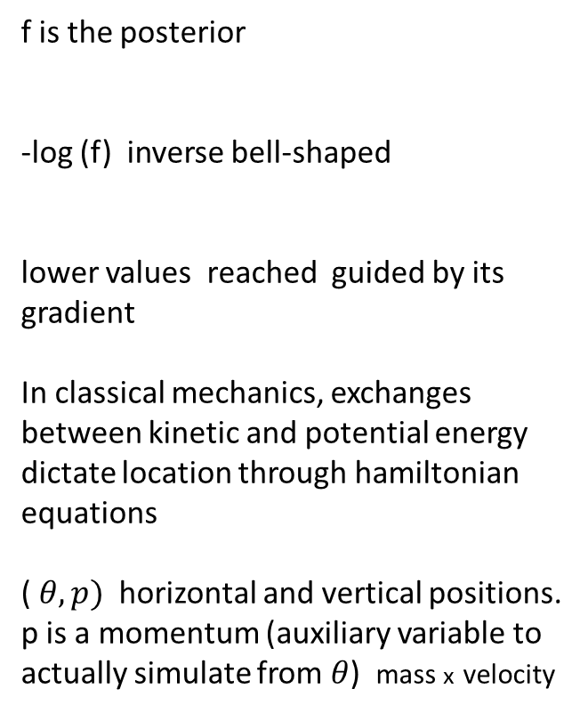
HMC. Idea
f is the posterior
-log (f) inverse bell-shaped
lower values reached guided by its gradient
In classical mechanics, exchanges between kinetic and potential energy dictate location through hamiltonian equations
( $θ, p)$horizontal and vertical positions.
p is a momentum (auxiliary variable to actually simulate from $θ$) mass x velocity

Slide 82
Hamiltonian equations and MCMC
Target is posterior. Auxiliary momentum (same dimension)
Hamiltonian as potential + kinetic
Hamiltonian equations

Slide 83
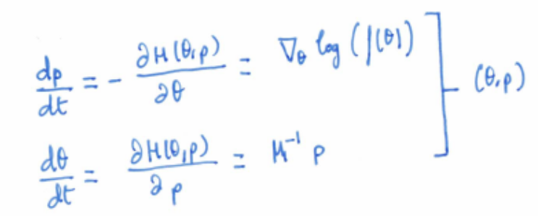
Hamiltonian equations through leapfrog

Slide 84
HMC. Algo I

Slide 85
HMC. Algo II

Slide 86
HMC Tuning
epsilon. Small relative to parameter of interest
x Number of leapfrog steps. L small, random walk nature
L large, wasted computation
Jointly acceptance rate of 65%
Examine for correlations
Adaptively select L as in No U-turn Sampler (NUTS) . Hoffman and Gelman
Implemented in Stan. Also adaptively chooses epsilon
Covariance matrix M

Slide 87
Hamiltonian MC. Examples

Slide 88
Typical setup

Slide 89
Sampling the bi-variate normal
Simple example to recall approach
Model. Bivariate normal with unknown means. Variances 1. Known correlation $ρ$
1 observation
Prior. Uniform
Use. Expected value and variance of parameters, Expected cross product, Probability that parameter belongs to a set

Slide 90
Sampling the bi-variate normal. Model and posterior

Slide 91
Sampling the bi-variate normal. Gibbs sampler

Slide 92
Sampling the bi-variate normal. Metropolis Hastings

Slide 93
Sampling the bi-variate normal. Metropolis Hastings

Slide 94
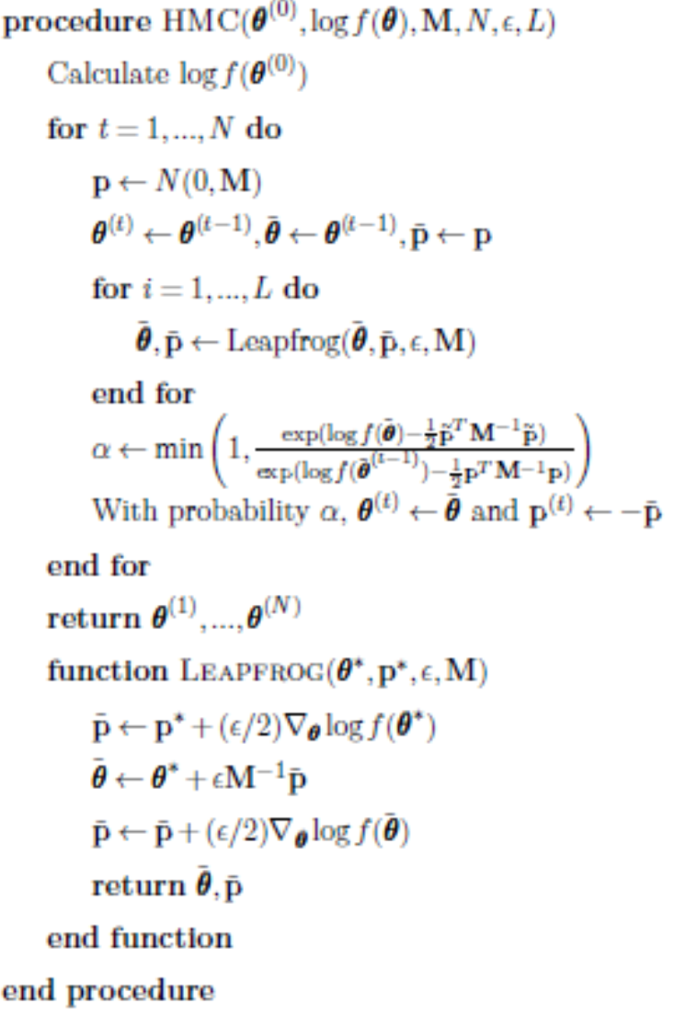
Sampling the bi-variate normal. Hamiltonian MC

Slide 95
Sampling the bi-variate normal. Hamiltonian MC. Bonus

Slide 96
Sampling the bi-variate normal. Answers (Whatever the method used)

Slide 97
Linear regression model
Inv-gamma prior for variance
Normal
Prior for weights

Slide 98
Linear regression model

Slide 99
Logistic regression model

Slide 100
Logistic regression model

Slide 101
Almost final comments
Gibbs. Lots of hard prior work. Not always implementable. If so may work well.
Metropolis Hastings. Less prior work. Quite general. May work slowly.
Hamiltonian. Even less work (although gradient needs to be computed) Quite general. Works more efficiently if well tuned) …. Yet suffers in large scale problems
We turn now into Stan
More when introducing SG-MCMC and Variational inference

Slide 102
HMC. Stan

Slide 103
PPL
Syntaxis inherited from BUGS
Stan files defining models
Automatic transformations!!!
Automatic differentiation!!!
Automatic tuning of parameters!!!
Monitoring convergence, etc

Slide 104
Stan 1. Learning mean, normal model + variants
Stan 2. Learning proportion + variants
Stan 3. Learning linear model + ANOVA

Slide 105
d. Complements

Slide 106
Further variants

Slide 107
Further variants
There’s many other variants
Slice sampling, simulated tempering, parallel tempering,…
We sketch here two: reversible jump sampling and particle filtering
Later we mention SG-MCMC variants

Slide 108
Reversible jump
In many complex problems we need to do trans-dimensional Markov chain simulation
Mixtures with unknown number of components
Shallow neural nets with unknown number of hidden nodes
Model averaging
Bartmachine
Parameters=(indicator of model, parameters of such model)
Within the model, a ‘standard’ Markov chain (Gibbs, MH, HMC, etc…)
Between models, Metropolis Hastings with reversible moves (jumps, collapsing and splitting models…)
See classic paper by Peter Green

Slide 109
Particle filtering
For nonlinear sequential problems, MCMC gets complex
Generate initial sample at time t=0
Let them evolve (and learn) according to nonlinear sequential model
Introduce rules to avoid collapse of particles

Slide 110
Inference and assessing convergence

Slide 111
Inference
Once convergence detected, collect samples from posterior and perform inference (point estimates, intervals, hypothesis tests, predictions and expected utility computations) via Monte Carlo (recall uncertainty associated, they are stochastic algos!!!)

Slide 112
Difficulties
If iterations have not proceeded long enough, target is not approximated well, samples are unrepresentative of target!!!
Early iterations may bias results
Autocorrelation impacts precision of estimates and the effective number of samples may be smaller than the one actually drawn (as if we’d be using a smaller number of samples)

Slide 113
Solutions
Runs to allow for effective monitoring of convergence (based on multiple chains, recall labs)
Monitor convergence by comparing variation within and between simulated sequences (until within and between variation are similar)
Modifying the algorithm by reparameterising or learning good parameterisations, if efficiency is very low (algo too slow)
Discarding initial values
Thinning
Take into account AC when estimating precisions

Slide 114
Discarding early iterations
Rule of thumb: Discard first half of iterations (warm-up, burn-in) and use the second half of iterations for inference and prediction
Warm-up fraction may vary
Warm-up fraction may adapt
Example. Run 200. Discard first 100. If second 200, do not suggest convergence, run 200 more and discard first 200.

Slide 115
Thinning iterations
Mitigate autocorrelation: keep every k-th simulation draw and discard the rest (to avoid storage problems also!!!)
Rule of thumb: Choose k to save up to 1000 draws

Slide 116
Assessing convergence
Comparing different simulated sequences from multiple chains with overdispersed starting points
Compare variance within each sequence with variance between sequences
Monitoring various scalar estimands (and other quantities of interest like the logposterior) separately
Checking mixing and stationarity
Split each series in two parts
after discarding burn-in
Check R
coda
monitor

Slide 117
Effective number of simulation draws
Once simulated sequences judged to have mixed, estimate effective number of simulation draws for any estimand of interest
If draws within each sequence truly independent, B would be an unbiased estimator of the posterior variance and we’d have mn independent observations
But typically will be autocorrelated and E(B) will be larger than the posterior variance

Slide 118
Effective number of simulation draws
We have
And define the effective simple size as
We estimate it through

Slide 119
e. Problems with large scale models and SG-MCMC intro

Slide 120
Sources
Blei, Kucukelbir, McAuliffe (2017)
Ma, Chen, Fox (2015)
Gallego, DRI (2022)

Slide 121
Computational problem in Bayesian analysis
Computing the posterior
Large scale problems. The modern statistical paradigm (but not always and not for the whole problem)
What if the amount of data is large? (Big data problems)
What if the amount of parameters is large? (e.g. neural nets)

Slide 122
Motivation. Mixtures

Slide 123
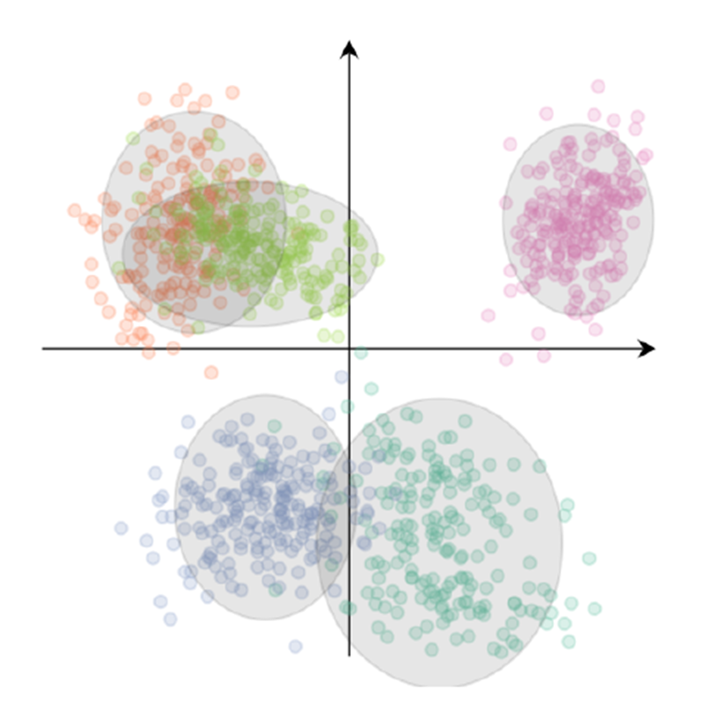
Mixture of gaussians
Mixture of K unit-variance (1-d) Gaussians
For each observation x, a cluster assignment c
Full model is
Joint density of parameters, latent and observed variables

Slide 124
Mixture of gaussians
Evidence v1
Evidence v2

Slide 125
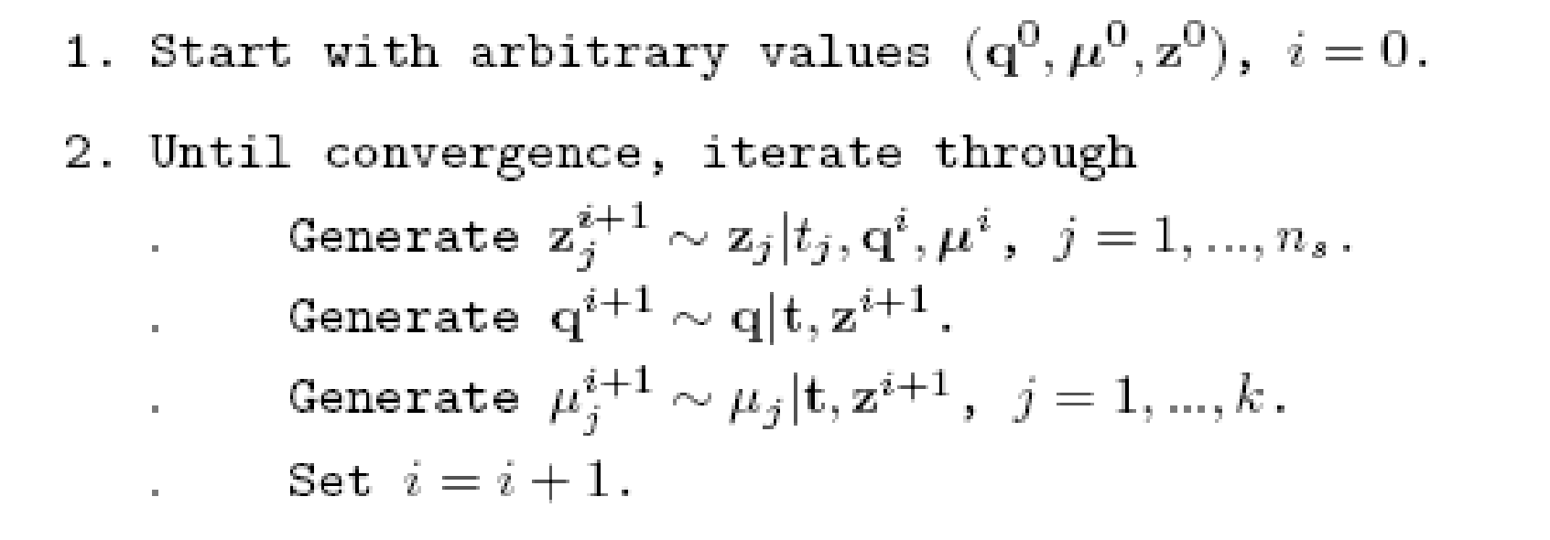
Problems with Gibbs sampler for mixtures
This is the Gibbs sampler for exponential mixtures, but structure is general
And similarly for MH and HMC, does not scale….
Think also in terms of large number of parameters….

Slide 126
Motivation. Neural Nets

Slide 128
HMC

Slide 129
SG-MCMC

Slide 130
MCMC in large scale problems
Big data
Gibbs is latent variables, pass through all data (and anyways not always usable)
MH and HMC both require likelihood or log-likelihood, pass through al data
Big number of parameters (eg deep models)
If implementable, many Gibbs steps per cycle (partly alleviated by joint samples)
MH and HMC a very long chain of computations to evaluate the factor related with posterior or log-posterior… and the gradient
Big data and big number of parameters…. We are in deep sh****t!!!

Slide 131
MCMC. Our aim (modern view)
From sampling from the posterior
where
to sampling from
with

Slide 132
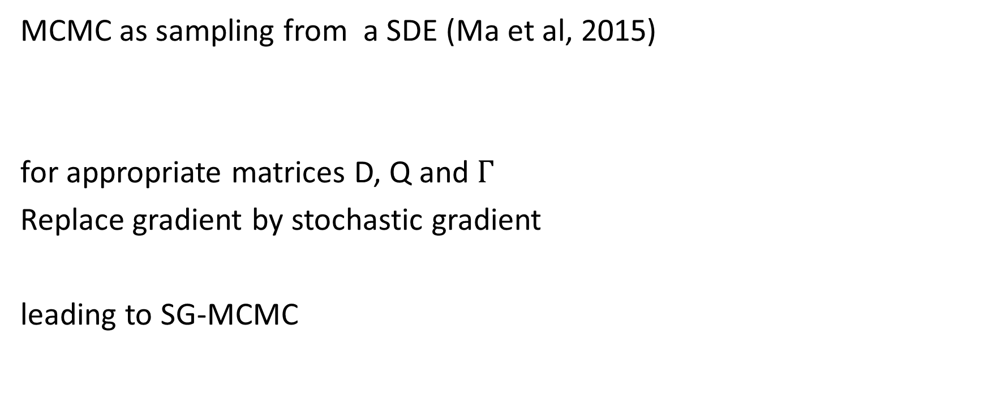
From MCMC to SG-MCMC
MCMC as sampling from a SDE (Ma et al, 2015)
for appropriate matrices D, Q and $Γ$
Replace gradient by stochastic gradient
leading to SG-MCMC

Slide 133
Final comments

Slide 134
SG-MCMC
Still a very open area
Combinations of VI and SG-MCMC

